Slide 1
NextHikes IT Solutions Telecom User Analytics Project Customer Behavior, Engagement, Experience & Satisfaction
- Presented by Parul Srivastava

Slide 2
Objective
Analyze telecom user behavior
Evaluate engagement & experience
Predict customer satisfaction
Provide business recommendation

Slide 3
Dataset Overview
Large telecom dataset (users, sessions, apps)
Key variables: DL, UL, RTT, TCP, Apps
Missing values handled using mean

Slide 4
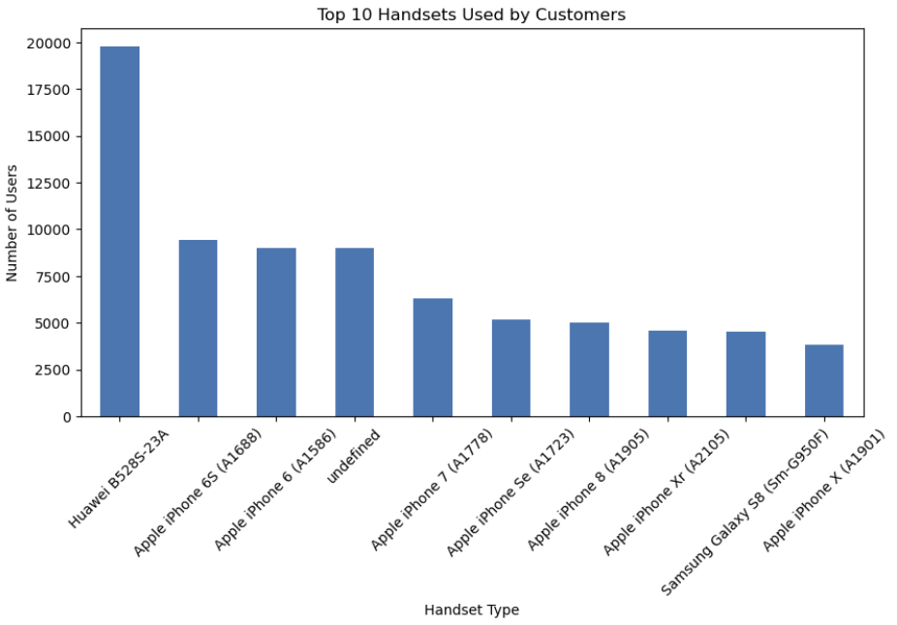
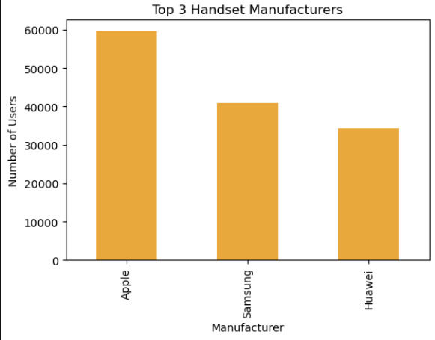
Top Devices & Manufacturers
Insights:
Market highly concentrated
Dependency on few brands

Slide 5
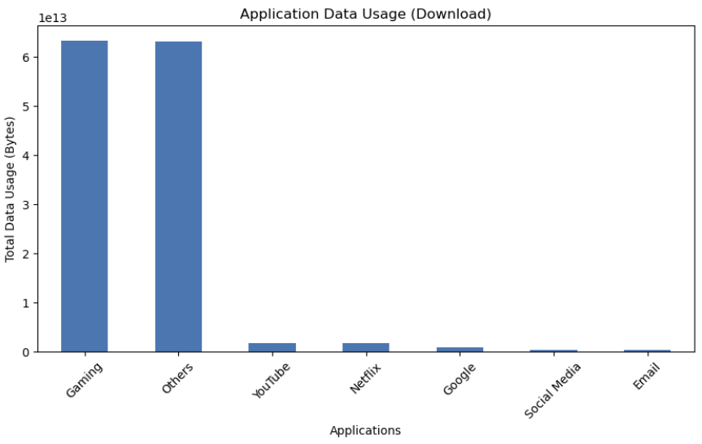
Application Usage

Slide 6
Engagement Metrics
Session frequency
Duration
Total Traffic

Slide 7
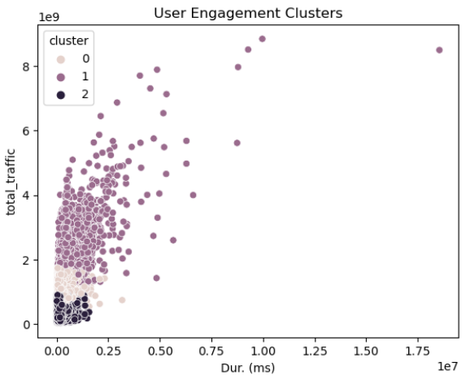
User Segmentation (K-Means)
3 clusters:
High engagement
Medium
Low
Insight:
Small % users generate majority traffic

Slide 8
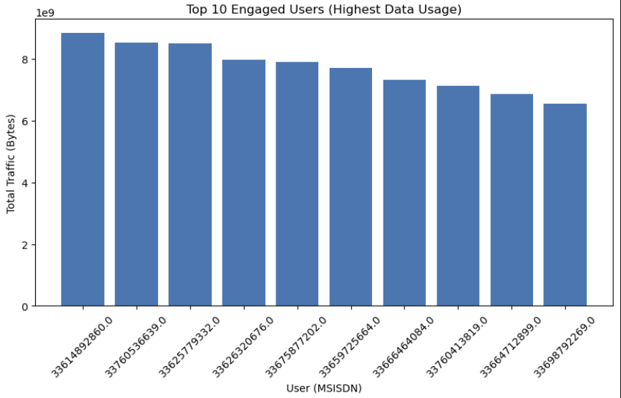
Top Engaged Users
Business Value:
Target premium customers

Slide 9
Network Performance Metrics
TCP retransmission
RTT (latency)
Throughput

Slide 10
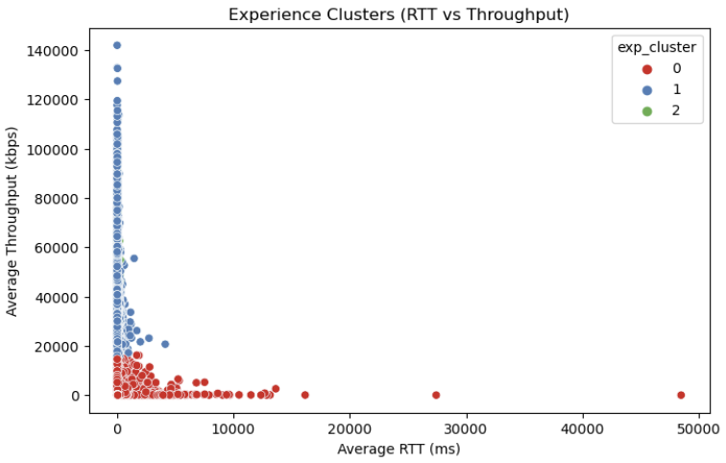
Experience Clusters
Best, Average, Poor experience users
Insight:
High RTT + TCP → poor experience

Slide 11
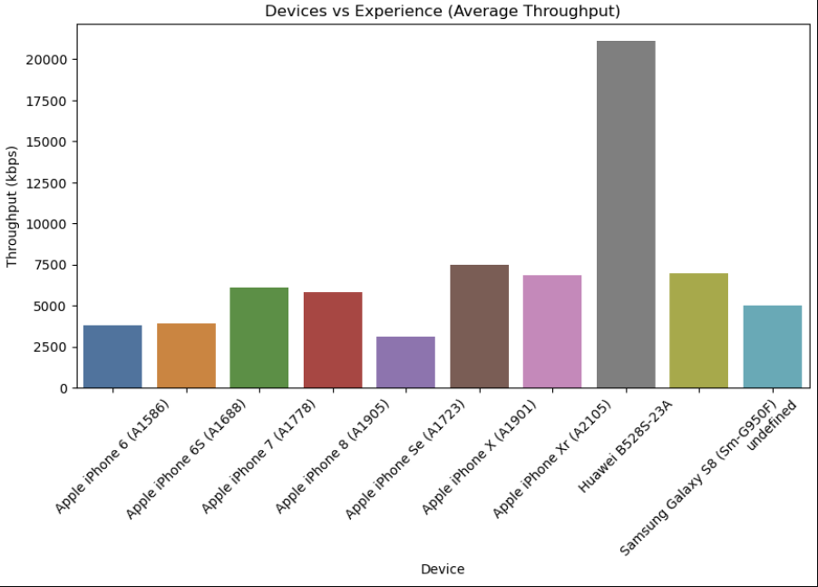
Device vs Experience
Some devices perform worse
Insight:
Device optimization needed

Slide 12
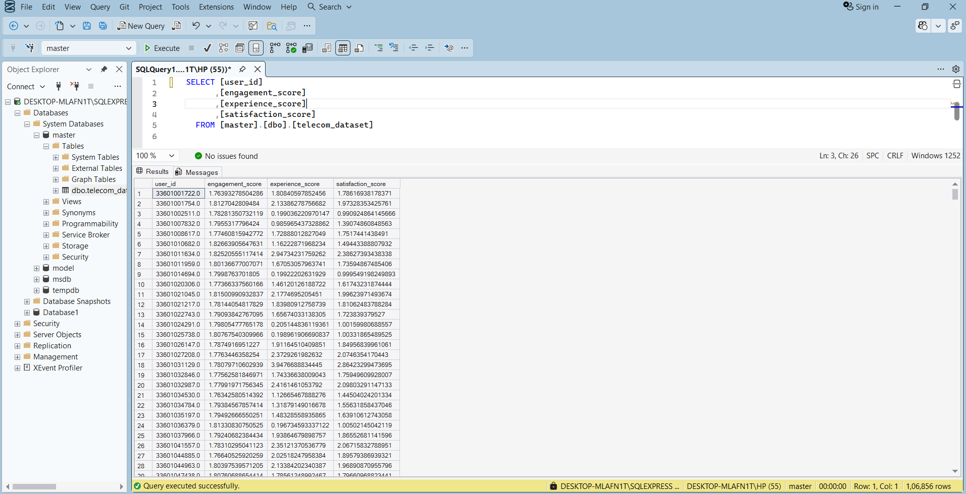
Satisfaction Model
Satisfaction = Engagement + Experience

Slide 13
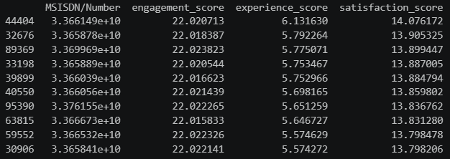
Top 10 Satisfied Users
High engagement + good experience

Slide 14
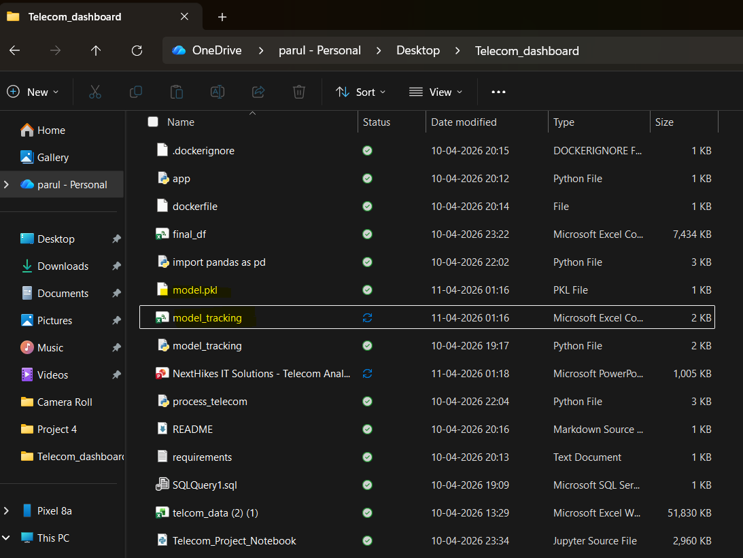

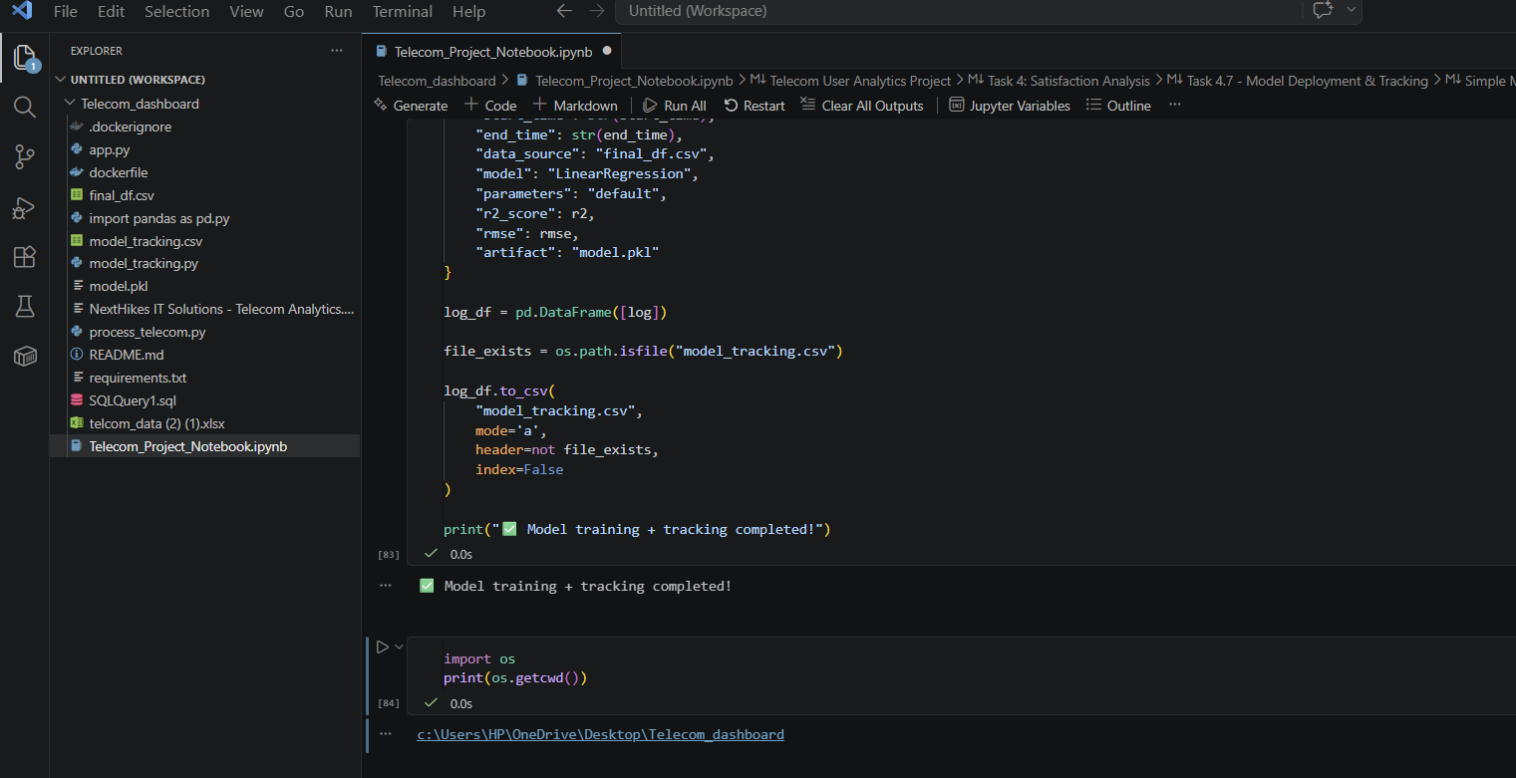
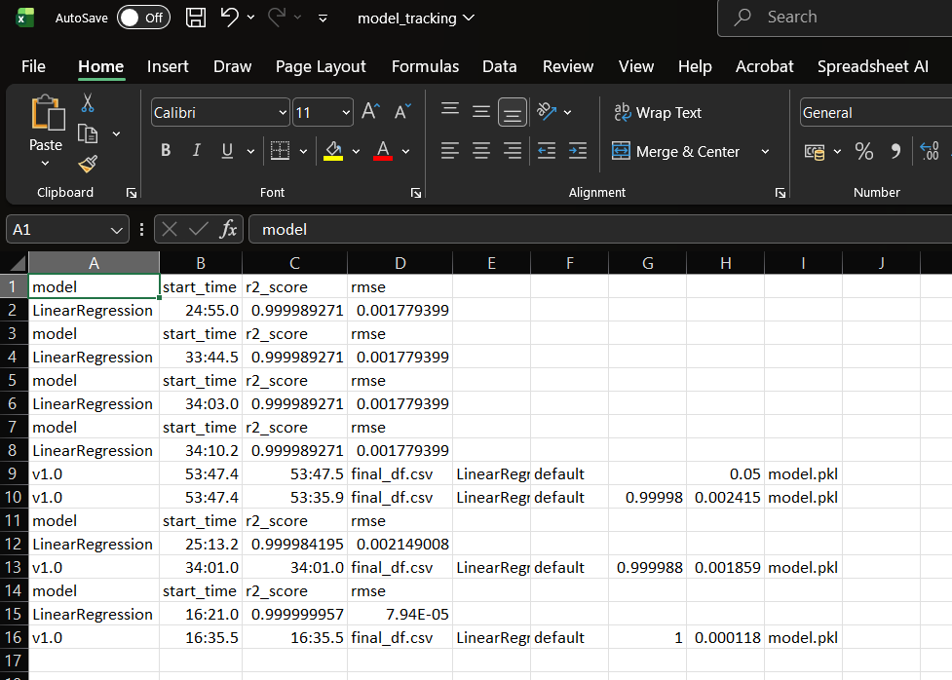
Regression Model
R² score → strong prediction ,RMSE → low error
Insight:
Model is reliable

Slide 15
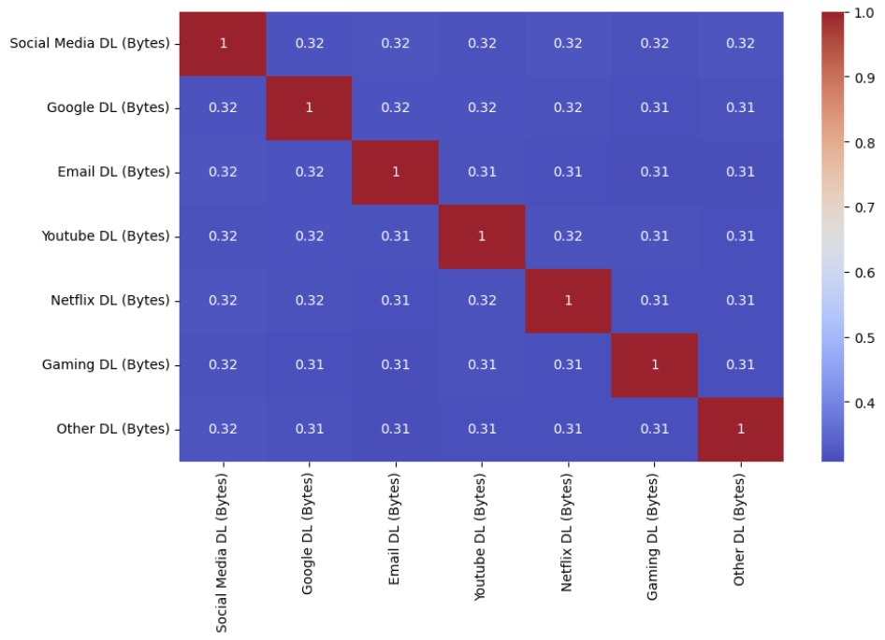
Heatmap (Correlation)
Insight:
Strong correlation between video apps
Similar user behavior patterns

Slide 16
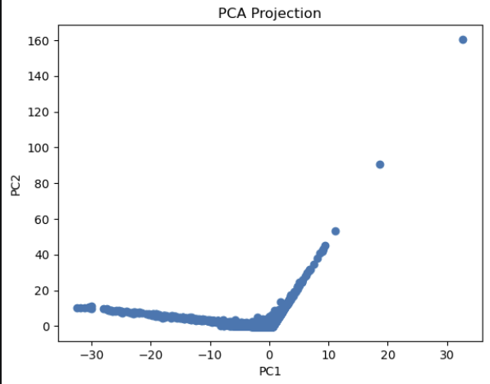
PCA (Dimensionality Reduction)
Insight:
Reduced dimensions
Clear user grouping

Slide 17
Key Findings
High engagement drives revenue
Poor network reduces satisfaction
Video apps dominate usage
User behavior is highly segmented

Slide 18
Growth Potential
📈 POSITIVE
Increasing data consumption
High engagement users
Strong demand for digital services
⚠️ RISKS
Network quality issues
Device dependency
Uneven user distribution

Slide 19
Final Recommendation
👉 YES — PURCHASE RECOMMENDED (WITH CONDITIONS)
✔ Strong growth potential ✔ High user engagement ✔ Revenue opportunity
⚠ Must improve:
Network QoS
Customer experience

Slide 20
Limitations & Conclusions
Limitations:
Missing values replaced with mean
Reduced dataset for deployment
Assumes linear relationships
No real-time data
Conclusion:
Company has strong growth potential
Requires network improvements
Acquisition recommended

Slide 21
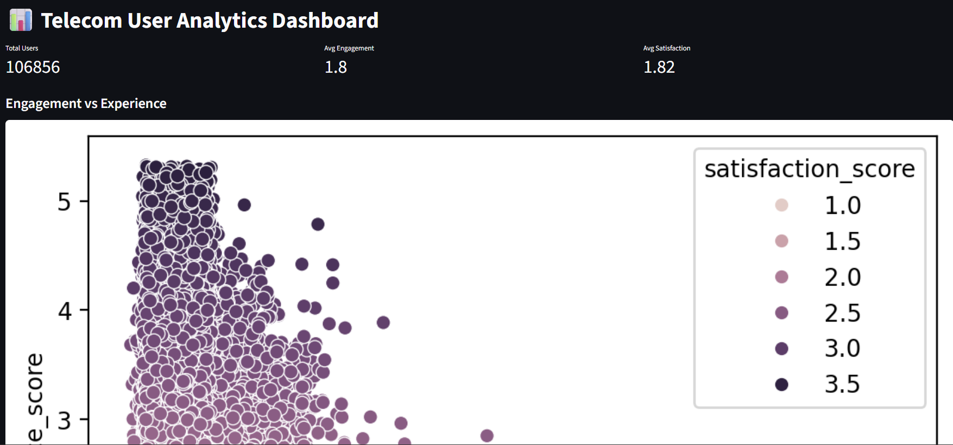
Thank You…
Telecom Dashboard

